Slide 1

SMART INDIA HACKATHON 2026
TITLE PAGE
Problem Statement ID – 26052
Problem Statement Title-To develop an AI/ML-enabled adaptive noise cancellation (ANC) system that effectively suppresses stationary, non-stationary, and impulsive defence noises while maintaining high speech intelligibility and real-time performance on embedded hardware.
Theme- Miscellaneous
PS Category- Hardware
Team Name - Phoenix

Slide 2
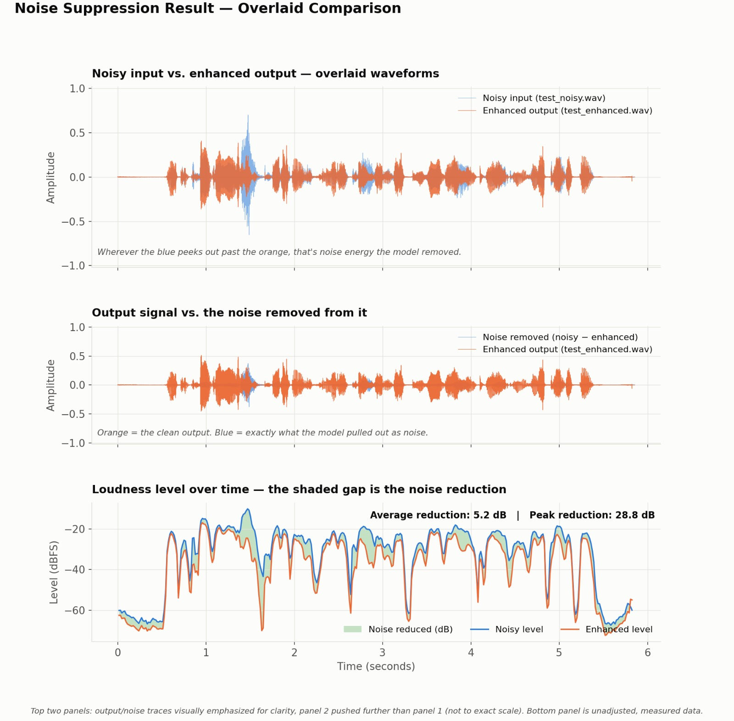
ADAPTIVE AI SPEECH ENHANCEMENT FOR DEFENCE COMMUNICATION
Phoenix
An AI/ML-based adaptive noise cancellation system for real-time defence communication.
Suppresses stationary, non-stationary, and impulsive battlefield noise directly on embedded hardware.
1. PROPOSED SOLUTION
CAPTURE[3][4]
Speech + Defence Noise
ANALYZE
Speech & Noise Characteristics
ADAPT
Changing Noise Conditions
AI ENHANCE
Suppress Noise + Preserve Speech
EDGE PROCESS
Low-Latency Local Inference
OUTPUT
Intelligible Speech
Paste image here
2. HOW IT ADDRESSES THE PROBLEM
Noise Suppression: removes noise, keeps speech clear
Dynamic Adaptation: adjusts to changing noise conditions
Impulsive Response: reacts instantly to sudden loud sounds
Speech Preservation: keeps voice clear and intelligible
Edge Processing: local processing for faster response
3. INNOVATION & UNIQUENESS
Defence-Specific AI[5]: extended with curated defence-relevant sounds
Dynamic Adaptation: auto-adjusts as surrounding noise changes
Sudden-Noise Handling: fast response without losing speech
No Reference Noise Needed: works from microphone input alone
Edge AI Processing: runs on-device, no internet dependency

Slide 3
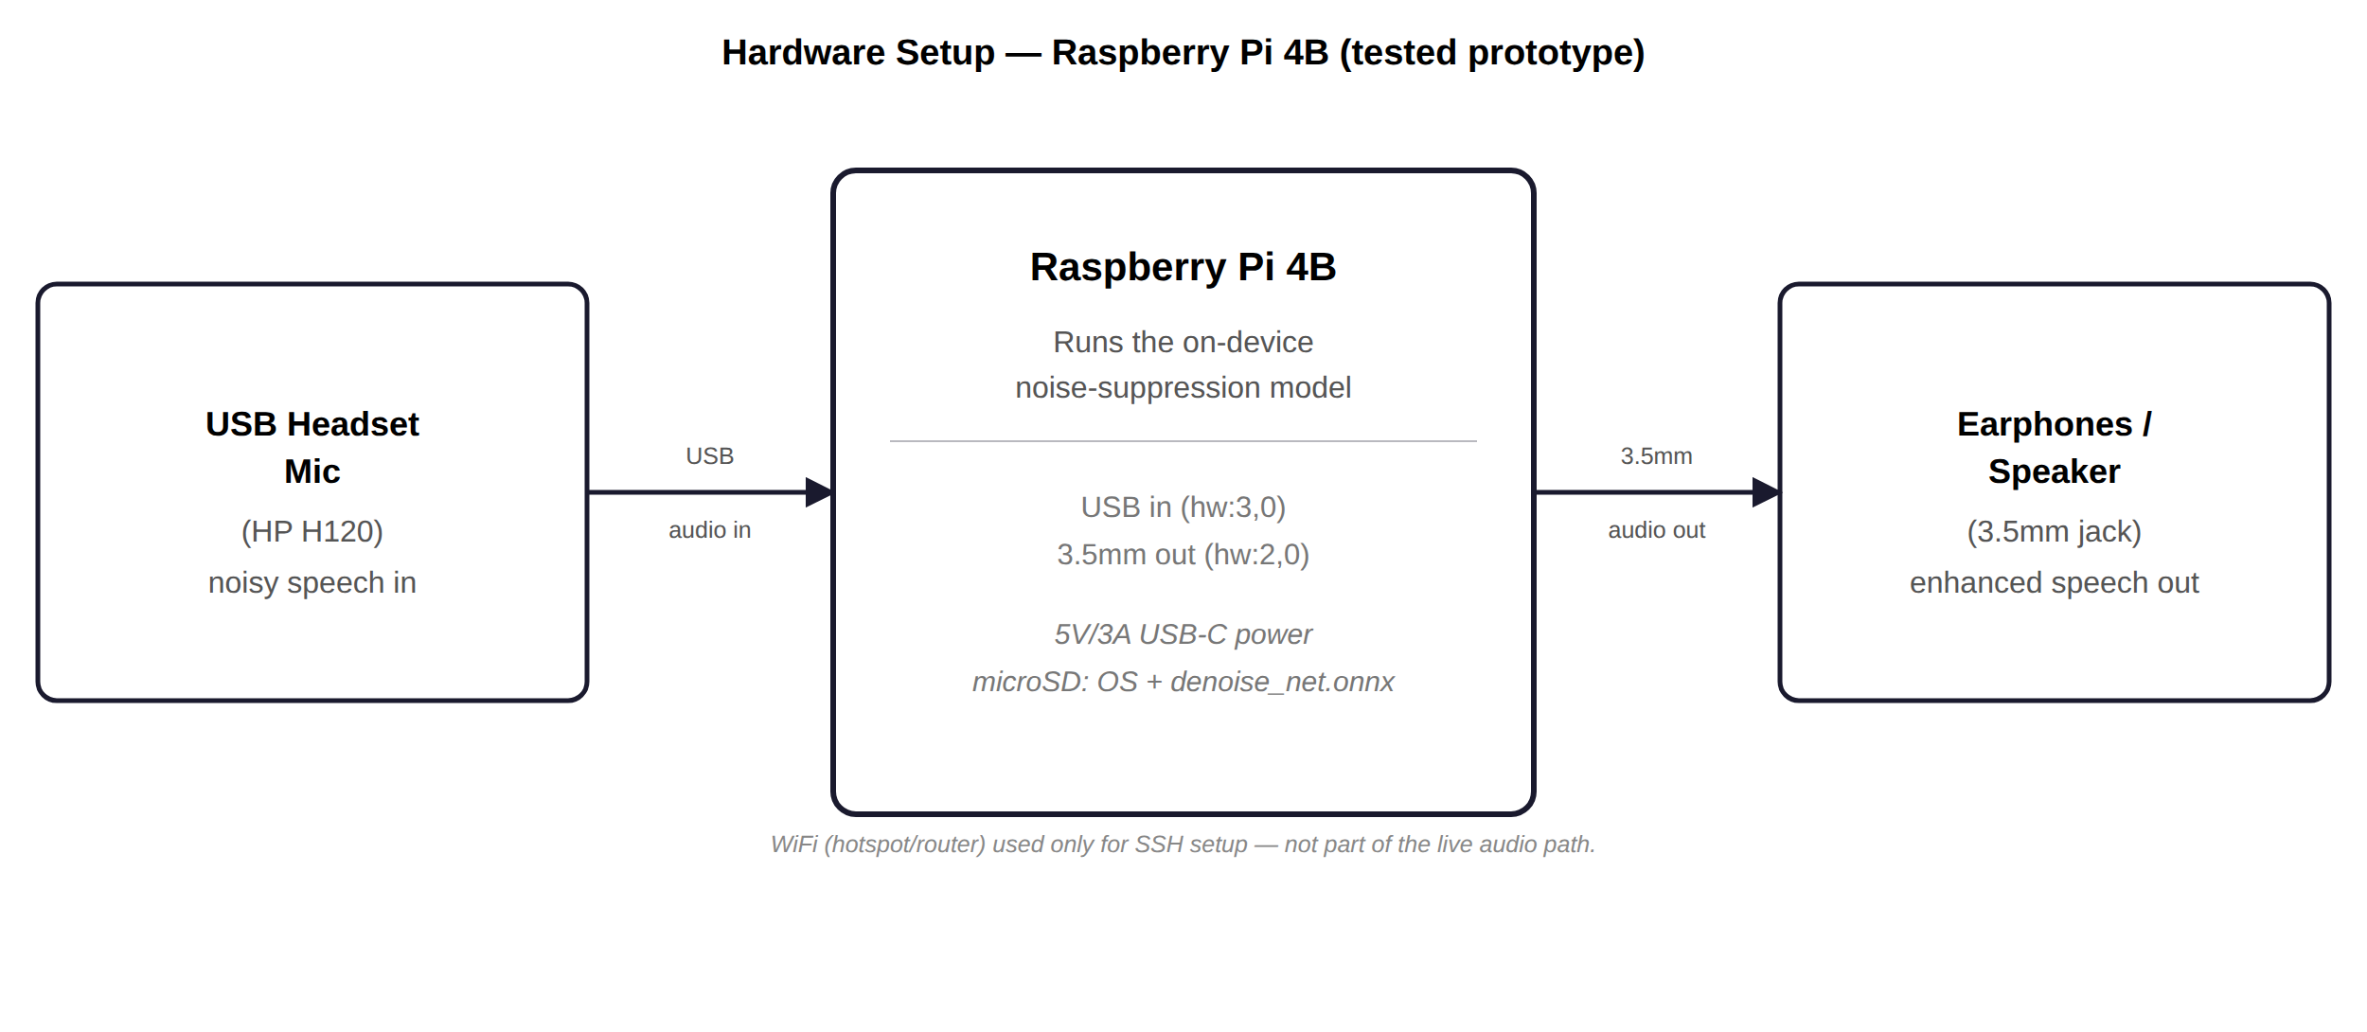
TECHNICAL APPROACH
Phoenix
1. TECHNOLOGIES USED
Python
Core implementation language
PyTorch
Model training (laptop)
ONNX Runtime
Lightweight edge inference
NumPy & SciPy
STFT / signal processing
GRU Neural Network [1][2]
Real-time noise-mask model
Raspberry Pi 4/5 (ARM64)
Embedded deployment target
2. METHODOLOGY
Real-Time Processing Pipeline (Raspberry Pi)
Microphone
Input
STFT
Framing
Neural Mask
Prediction
Apply Mask to
Spectrum
Overlap-Add
Reconstruction
Enhanced Audio
Output
Result: Noisy Speech → Real-Time Adaptive Noise Suppression → Clear, Intelligible Speech

Slide 4
FEASIBILITY AND VIABILITY
Phoenix
FEASIBILITY
VIABILITY
🧠
Lightweight AI
⚡
Edge Processing
💰
Cost Effective
🔒
Offline Operation
GRU + STFT for edge-ready enhancement
ONNX Runtime + Raspberry Pi 4/5
Low-cost, commercially available hardware
Local inference; no cloud dependency
📊
Accessible Data[3][4]
⏱
Real-Time Pipeline
📈
Scalable
🎧
Practical Impact
Public speech + synthetic noise
Streaming STFT → mask → output
Prototype → advanced communication systems
Clearer speech in high-noise environments
⚠ CHALLENGES → 🛠 SOLUTIONS
🔊
Changing / non-stationary noise
→
🧠
Adaptive GRU-based suppression
💥
Impulsive noise
→
🎯
Adaptive masking trained on real transient-noise examples (claps, clicks, glass
breaks,fireworks)
🗣
Speech distortion
→
🗣
Speech-preservation objective
⏱
Embedded latency
→
⚡
Lightweight model + ONNX optimization
📊
Limited defence data
→
📚
Public + synthetic noise generation

Slide 5
IMPACT AND BENEFITS
Phoenix
Impact on target audience
Defence Organizations
Clearer commands, Less communication errors, reliable
Communication Operators
Better speech intelligibility, reduced listening
effort
Benefits
🗣
COMMUNICATION IMPACT
💰
ECONOMIC
⚡
OPERATIONAL RESILIENCE
Better understanding & coordination
Low-cost and scalable technology
Designed for demanding environments
1.
Safer communication
1.
Cost-effective
1.
Offline operation
Speech enhancement continues without internet.
Critical instructions remain easier to understand.
Uses commercially available embedded hardware.
2.
Reduced listening effort
2.
Low infrastructure dependency
2.
Adaptive noise handling
Local processing reduces cloud requirements.
Targets stationary, changing and impulsive noise.
Less effort to distinguish speech from noise.
3.
Better coordination
3.
Scalable
3.
Real-time edge AI
Can extend from prototype to communication systems.
Low-latency local processing for immediate output.
Supports clearer communication between personnel.

Slide 6
REFERENCES
Phoenix
[1] Valin, J.-M. — "A Hybrid DSP/Deep Learning Approach to Real-Time Full-Band Speech Enhancement" — MMSP 2018.
[2] Schröter, Escalante-B., Rosenkranz, Maier — "DeepFilterNet2: Towards Real-Time Speech Enhancement on Embedded Devices for Full-Band Audio" — IWAENC 2022.
[3] Panayotov, V., Chen, G., Povey, D., Khudanpur, S. (2015). LibriSpeech: An ASR Corpus Based on Public Domain Audio Books. IEEE ICASSP 2015. — source of the clean speech training data (dev-clean subset).
[4] Kominek, J., Black, A.W. (2004). The CMU Arctic Speech Databases. 5th ISCA Speech Synthesis Workshop. — additional source of clean speech training data.
[5] Piczak, K.J. (2015). ESC: Dataset for Environmental Sound Classification. ACM Multimedia 2015. — source of the environmental/noise training data (ESC-50).

